Slide 1
SJSU CS 46A Introduction to Programming
When you come in
Open Canvas
Download Exam1Review.pptx
No iClicker today

Slide 2
Grading Rules Implemented in Canvas
iClicker
Drop the first two and the lowest of the rest
Pars
Drop the first two and the lowest of the rest
Labs
Drop the lowest three
Homework
Drop the lowest

Slide 3
Exam1
Date: Thursday, Oct 06
Time: 1:30 – 2:45
QuizForExamOne
Rules
Grading
Notes:
Sections 2.5 – 2.8

Slide 4
Submission
The Codecheck server will be modified to the Frog class and fail any submissions at 2:45.
You should prepare for the last submission at 2:35 and make the last submission to Codecheck by 2:40.
Canvas due time: 3:00; Grace time: 3:10.
You will receive 5 submission points if you follow the rules and submit all signed.zip files together to Canvas before 3:00.
You will not receive the 5 submission points if your submission is marked as Late.
You will not receive any points for the exam if your submission is rejected by Canvas.
Notes:
Sections 2.5 – 2.8

Slide 5
Room
Each student should have one room without any other persons during the exam
Good Internet Connection
Reversed Room
Room 229 MacQuarrie Hall
(Mathematics Conference Room)
Please email me if you plan to go to MH 229

Slide 6
What Will be Covered in Exam1?
Chapter 1: Introduction
Chapter 2: Using Objects
Chapter 3: Implementing Classes
Chapter 4: Fundamental Data Types
Chapter 5: Decisions
Notes:
Sections 2.5 – 2.8

Slide 7
Course Description
Basic skills and concepts of computer programming in an object-oriented approach using Java.
Classes, methods and argument passing, control structures, iteration.
Basic graphical user interface programming.
Problem solving, class discovery and stepwise refinement.
Programming and documentation style.
Weekly hands-on activity.

Slide 8
Students Learning Outcomes
Upon completion of this course, students should be able to:
Analyze and explain the behavior of programs involving the fundamental program constructs
Write short programs that use the fundamental program constructs including standard conditional and iterative control structures
Identify and correct syntax and logic errors in short programs
Choose arrays or array lists for a given problem and write short programs that use arrays or array lists
Design and implement a class based on attributes and behaviors of objects
Construct objects using a class and activate methods on them
Write Javadoc comments for classes and methods
Write graphics program that draws simple shapes
Use interfaces and inheritance to describe common behavior of classes and write programs that use that common behavior
Use an integrated development environment and a debugger

Slide 9
SampleExam1
Four problems for 40 participation points
Password: SampleExamOne
Due time: 10 pm, Monday, Oct 03
Grace time: 10 am, Tuesday, Oct 04
Solutions: in Canvas after the grace time

Slide 10
Problem 1: Semantics and Syntax
Fixing syntax errors without changing the semantics of the statements

Slide 11
Problem 2: Input and Output
Using Scanner methods
No try-catch
No parse() methods
Validating input using Scanner
Data type
Value range
Terminating programs
Formatted output

Slide 12
Problem 3: Implementing Classes
Constants
Instance variables
Constructors
Methods
Stubs
Partial credit if some results in Codecheck
No credit if no results

Slide 13
Problem 4: Graphics Package
Importing the package
Figuring out the details
Location
Size
Programming
Creating a new class
Using existing classes

Slide 14
Do Your Best!
70 minutes for coding; 5 minutes for submission
Completing 4 problems in 70 minutes
17.5 minutes per problem
Completing 3 problems in 70 minutes
23.3 minutes per problem
Completing 2 problems in 70 minutes
35 minutes per problem

Slide 15
Not Too Difficult to Pass
Completing 2 problems in 70 minutes: 20 points
Submission and QuizForExamOne: 10 points
Exam1: 60% (30/50)
Exams: 60%
Others: 40%
60%
85%
0.6 * 0.6: 0.36
0.4 * 0.85: 0.34
Total:70% (0.7)
Grade: C-

Slide 16
My Current Total is 70%!
Exam1: 35/50 (70%)
CS 46A: C- (70%)
Completing 2 problems: 20 points
Submission and QuizForExamOne: 10 points
5 partial points for other two: 5 points

Slide 17
What If I Cannot Complete Two Problems in 70 Minutes?
Most likely you will fail CS 46A this semester
Come back in the future
DO NOT VIOLATE ANY RULES!

Slide 18
How to Prepare for Exam1
Reference Cards
Reference cards are documents created by students to contain whatever information they deem most necessary to have during exams.

Slide 19
The Benefits of Reference Cards
Many students report feeling confident in their knowledge of the content and remembering the important notes just from the process of creating the reference cards.

Slide 20
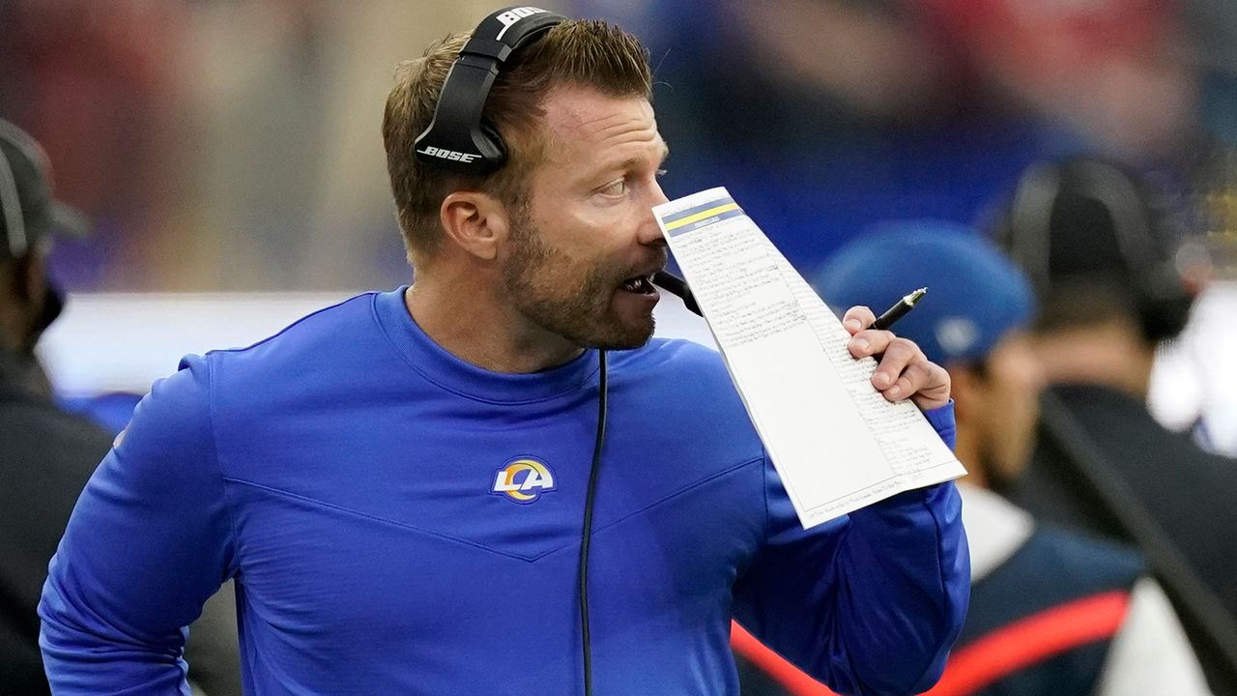
LA Rams Head Coach: Sean McVay
Notes:
Super Bowl 2021

Slide 21
How to Make a Reference Card
To create a reference card, students review their notes and the textbook, organize and prioritize the content, choose which notes they want to have during exams, and then write them onto the reference card.
My Reference Card: Slides 22 - 47

Slide 22
Primitive Data Types
int
double
char
boolean
byte
short
long
float

Slide 23
Why Data Types?
Different kinds of values
Different storage sizes
Limitations
Overflow
Different operations
7 / 5 : 1 (integer division)
7 / 5.0: 1.4 (float point division)
Notes:
Sections 2.5 – 2.8

Slide 24
Classes
Can be considered as special data types
String: Lesson04 and Lesson08
Scanner
Day
Picture, Rectangle, Ellipse from Graphics
Frog
Notes:
Sections 2.5 – 2.8

Slide 25
Public Interface of Classes
Constructor and Method headers with description
Implementing according to headers
Calling according to headers
Java Class Libraries
BlueJ documentation view
Notes:
Sections 2.5 – 2.8

Slide 26
Variables
A variable is a storage location with a name
Variable declaration
Must specify data type
With or without an initial value
Scope of variables
Instance variables
Local variables, including parameters
Block variables

Slide 27
Arithmetic Operations
Integer division and float (double) division
Remainder operator %
Math methods and constants
No need to import any class

Slide 28
Boolean Operations
Comparison operators
==
!=
>
>=
<
<=
Logical operators
&&
||
!

Slide 29
Output
System.out.println(message)
System.out.print(message)
System.out.println()
System.out.printf(message, value1, value2...)
Notes:
Sections 2.5 – 2.8

Slide 30
Formatted Output
Format specifiers used only with printf()
%7s: string
%3d: int
%7.2f: double
%n: next line
Escape sequences used inside strings with all output methods
\n: next line
\": double quote inside a string
Notes:
Sections 2.5 – 2.8

Slide 31
Formatted Output
String name;
double price;
System.out.printf("The price for \"%s\" is $%.2f.%n",
name, price);
The price for "iPad Pro" is $499.95.
(go to next line)
Notes:
Sections 2.5 – 2.8

Slide 32
Input: Class Scanner
import java.util.Scanner;
Scanner in = new Scanner(System.in);
next()
nextLine()
nextInt()
nextDouble()
hasNextInt()
hasNextDouble()

Slide 33
Must Use Scanner Methods
Do not use try-catch statement
Do not use any parse methods

Slide 34
Input Prompt
System.out.print("Enter an integer: ");
int intNum = in.nextInt();

Slide 35
Terminating When Input Invalid
System.out.print("Please enter your income: ");
if (!in.hasNextDouble())
{
String input = in.next();
System.out.println("Invalid income: " + input);
return;
}
// The next input token is a double
income = in.nextDouble();
. . .

Slide 36
The if Statements
if (Condition)
{
StatementBlock (one or more statements)
}
if (Condition)
{
StatementBlock1 (one or more statements)
}
else
{
StatementBlock2 (one or more statements)
}

Slide 37
Multiple Alternatives
if (Cond_1)
{
Block_1 (one or more statements)
}
else if (Cond_2)
{
Block_2 (one or more statements)
}
. . .
else if (Cond_n)
{
Block_n (one or more statements)
}
else
{
Block_0 (one or more statements)
}
Do not Use Independent if Statements!

Slide 38
No Empty if or else Blocks
if (in.hasNextInt())
{
}
else
{
System.out.println(“Invalid input.”);
return;
}

Slide 39
No Extra Conditions
if (score >= 90)
{
. . .
}
else if (score < 90 && score >= 80)
{
. . .
}
else if
. . .

Slide 40
Implementing Classes
Constants
Instance Variables
Constructors
Methods
Public vs private
Instance vs static

Slide 41
Instance Variables
Each object of a class has its own set of instance variables
Must be private
Can be accessed from all instance methods of the class
With or without reference this

Slide 42
Constructors
To initialize the instance variables
Default constructor
No parameters
Constructors with parameters
Not a method and no return type
Same name as the class

Slide 43
Using Existing Classes
Create an object of a class
Call methods on the object
Method parameters (arguments)
Picture pic = new Picture("redwood.png");
double dw = pic.getWidth() / 2.0,
double dh = pic.getHeight() / 2.0;
pic.grow(dw, dh);
pic.translate(50, 100);

Slide 44
Class String
public String substring(int beginIndex)
public String substring(int beginIndex, int endIndex)
public int indexOf(char ch)
public int indexOf(char ch, int fromIndex)
public int indexOf(String str)
public int indexOf(String str, int fromIndex)

Slide 45
Method Stubs
public void grow(int amount)
{
}
public int getLegs()
{
return 0;
}
public String toString()
{
return null;
}

Slide 46
Javadoc Tags
/**
* Increases the weight of this frog.
* @param amount the amount to increase the weight
*/
public void grow(int amount)
{
. . .
}
/**
* Gets the number of legs of this frog.
* @return the number of legs of this frog
*/
public int getLegs()
{
. . .
}

Slide 47
Debugging in BlueJ

Slide 48
Stay in the Main room
Par10 Solutions and Questions
Breakout Room 1
Ask Nik (SI Leader) any questions
My Office Hours
8 – 9 pm

